Slide 1
Tree

Slide 2
Tree Definitions and properties
A Tree is a recursive data structure containing the set of one or more data nodes where one node is designated as the root of the tree while the remaining nodes are called as the children of the root.
The nodes other than the root node are partitioned into the non empty sets where each one of them is to be called sub-tree.
Nodes of a tree either maintain a parent-child relationship between them or they are sister nodes.
In a general tree, A node can have any number of children nodes but it can have only a single parent.
The following image shows a tree, where the node A is the root node of the tree while the other nodes can be seen as the children of A.

Slide 3
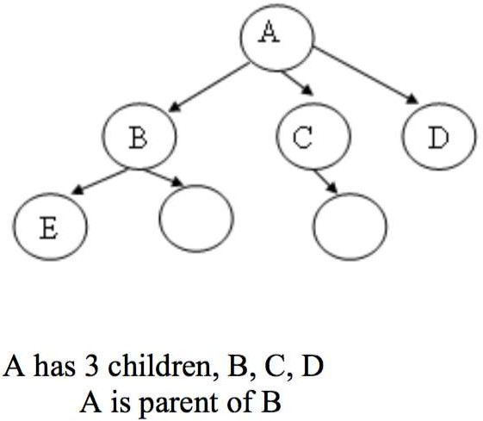
Tree
A tree is an abstract model of a hierarchical structure that consists of nodes with a parent-child relationship.
Tree is a sequence of nodes
There is a starting node known as a root node
Every node other than the root has a parent node.
Nodes may have any number of children

Slide 4
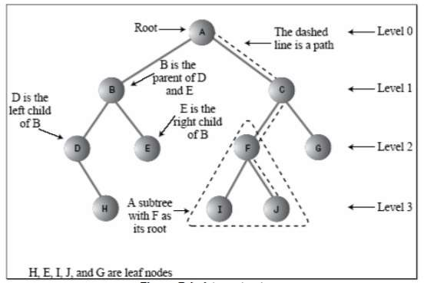

Slide 5
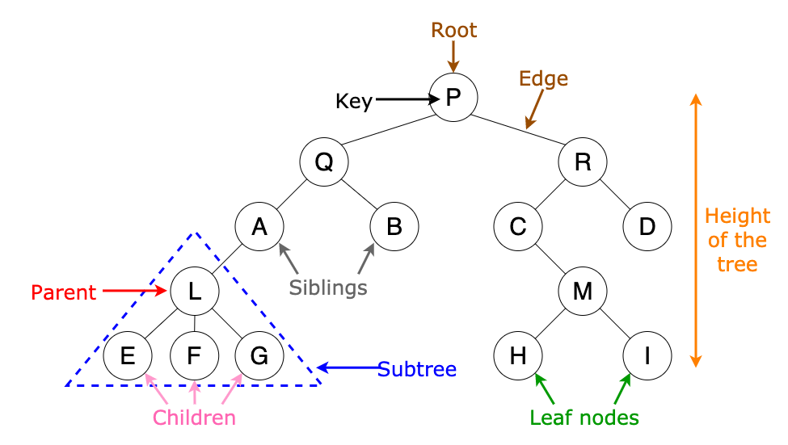

Slide 6
Tree common Terms:
Root − Node at the top of the tree is called root.
Parent − Any node except root node has one edge upward to a node called parent.
Child − Node below a given node connected by its edge downward is called its child node.
Sibling – Child of same node are called siblings
Leaf − Node which does not have any child node is called leaf node.
Sub tree − Sub tree represents descendants of a node.
Levels − Level of a node represents the generation of a node. If root node is at level 0, then its next child node is at level 1, its grandchild is at level 2 and so on.
keys − Key represents a value of a node based on which a search operation is to be carried out for a node.

Slide 7
Tree common Terms:
Degree of a node:
The degree of a node is the number of children of that node
Degree of a Tree:
The degree of a tree is the maximum degree of nodes in a given tree
Path:
It is the sequence of consecutive edges from source node to destination node.

Slide 8
Tree common Terms:
Height of a node:
The height of a node is the max path length form that node to a leaf node.
Height of a tree:
The height of a tree is the height of the root
Depth of a tree:
Depth of a tree is the max level of any leaf in the tree

Slide 9
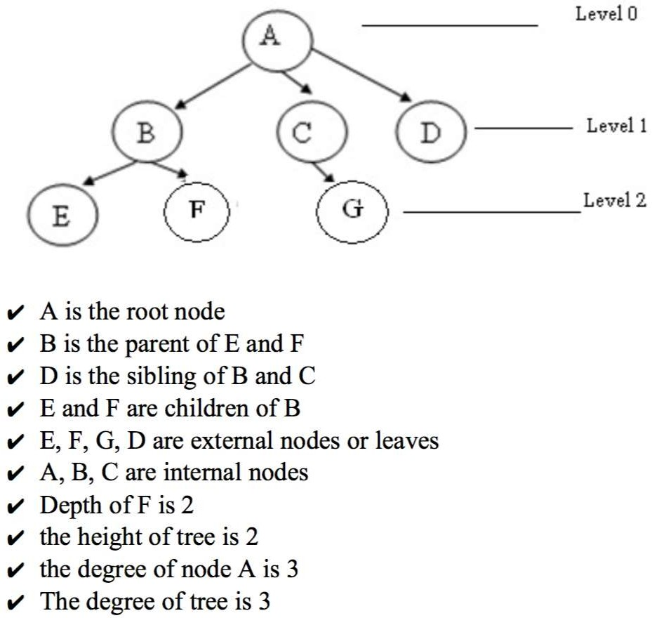

Slide 10
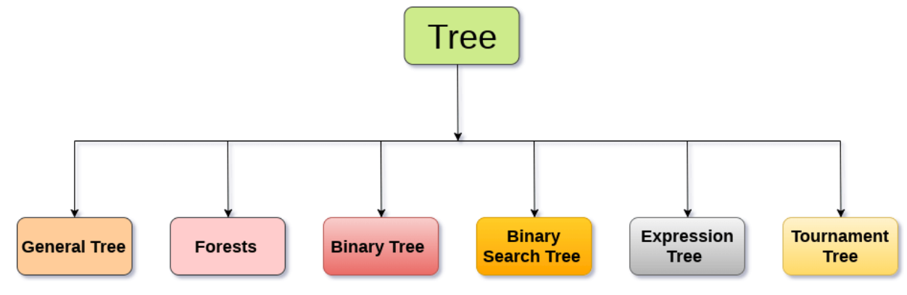
Types of Trees

Slide 11
Advantage of Tree
Trees reflect structural relationships in the data.
Trees are used to represent hierarchies.
Trees provide an efficient insertion and searching.
Trees are very flexible data, allowing to move subtrees around with minumum effort.

Slide 12
Binary Tree
Binary Tree is a special type of generic tree in which, each node can have at most two children. Binary tree is generally partitioned into three disjoint subsets.
Root of the node
left sub-tree which is also a binary tree.
Right binary sub-tree

Slide 13
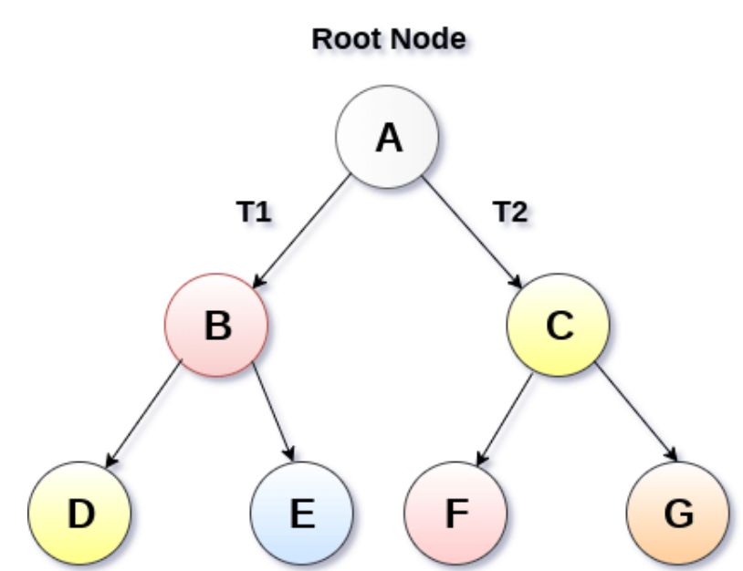
Binary Tree

Slide 14
Types of Binary Tree
Strictly Binary Tree
Complete Binary Tree

Slide 15
Strictly Binary Tree
Each non-leaf node contain non-empty left and right sub-trees.
The degree of every non-leaf node will always be 2.
A strictly binary tree with n leaves, will have (2n - 1) nodes.

Slide 16
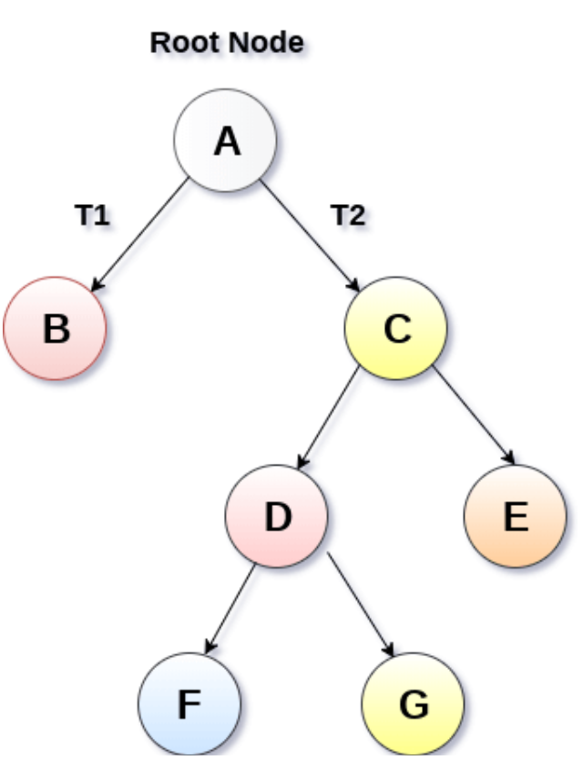
Strictly Binary Tree

Slide 17
Complete Binary Tree
A Binary Tree is said to be a complete binary tree if all of the leaves are located at the same level d.
A complete binary tree is a binary tree that contains exactly 2^l nodes at each level between level 0 and d.
The total number of nodes in a complete binary tree with depth d is 2^{d+1}-1 where leaf nodes are 2^{d} while non-leaf nodes are 2^{d}-1.

Slide 18
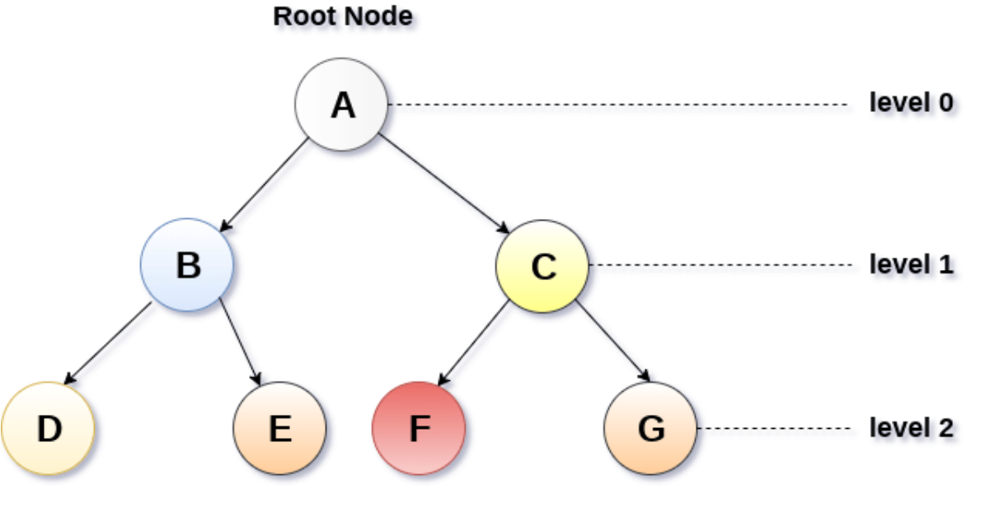
Complete Binary Tree

Slide 19
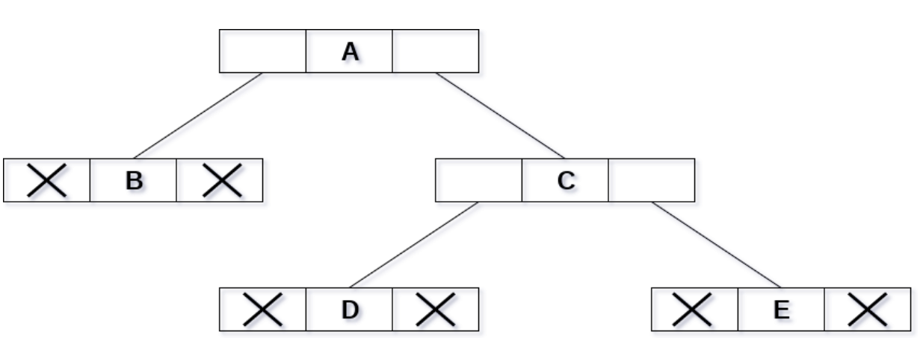
Binary Tree representation using Linked List

Slide 20
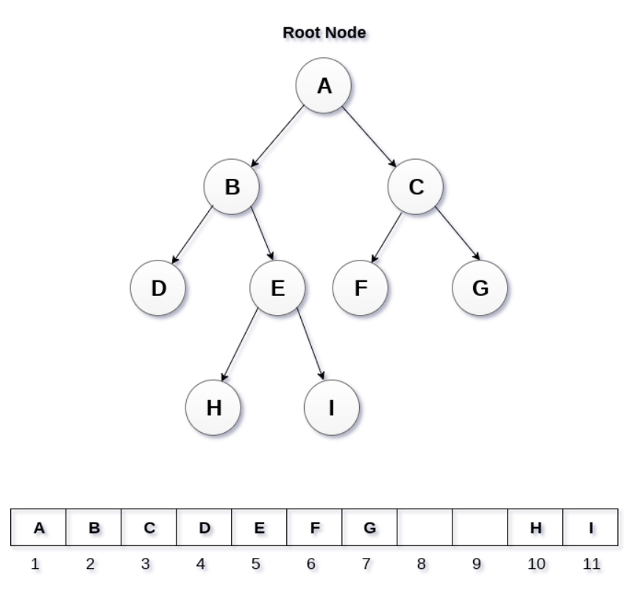
Binary Tree representation using Array
If a node is stored at ith index then its left and right children will be stored at 2i and 2i+1 location.
If the 1st index of the array i.e. tree[1] is 0, it means that the tree is empty.

Slide 21
Algorithm for binary tree traversal
Inorder(root)
Traverse the left sub-tree, (recursively call inorder(root -> left).
Visit and print the root node.
Traverse the right sub-tree, (recursively call inorder(root -> right).
Preorder(root)
Visit and print the root node.
Traverse the left sub-tree, (recursively call inorder(root -> left).
Traverse the right sub-tree, (recursively call inorder(root -> right).
Postorder(root)
Traverse the left sub-tree, (recursively call inorder(root -> left).
Traverse the right sub-tree, (recursively call inorder(root -> right).
Visit and print the root node.

Slide 22
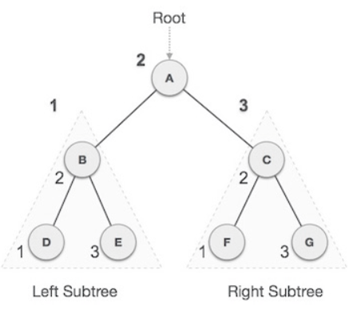
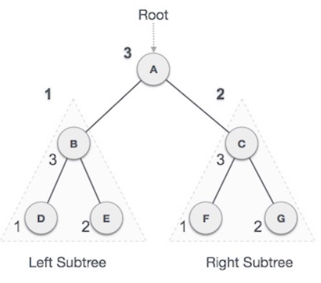
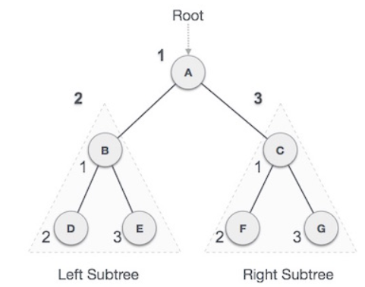
In-order Traversal
Pre-order Traversal
Post-order Traversal
D → B → E → A → F → C → G
A → B → D → E → C → F → G
D → E → B → F → G → C → A

Slide 23
Binary Search Tree
Binary Search Tree is a node-based binary tree data structure which has the following properties:
The left subtree of a node contains only nodes with keys lesser than the node’s key.
The right subtree of a node contains only nodes with keys greater than the node’s key.
The left and right subtree each must also be a binary search tree.

Slide 24
Seaching in BST
Searching a node in Binary Search Tree
Start from root.
Compare the inserting element with root.
if less than root, then recurse for left, else recurse for right.
If element to search is found anywhere, return true, else return false.

Slide 25
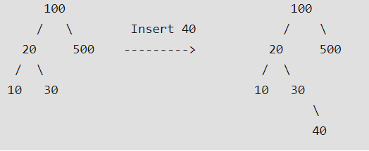
Insertion in BST
1. Start from root. 2. Compare the inserting element with root, if less than root, then recurse for left, else recurse for right. 3. If element to search is found anywhere, return true, else return false.

Slide 26
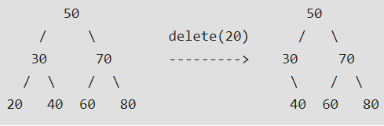
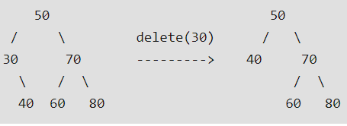
Deletion in BST
Node to be deleted is leaf: Simply remove from the tree.
Node to be deleted has only one child: Copy the child to the node and delete the child

Slide 27
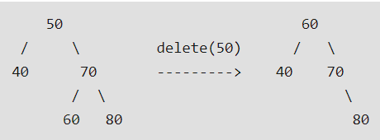
Node to be deleted has two children
Node to be deleted has two children
Replace: smallest child from the right subtree
Replace: largest child from the left subtree
Repeat above process with, replacing node as the root.
If node(60) had more child

Slide 28
Thank You

